Slide 1
Control unit

Slide 2
Fundamental Concepts
Single core
Multicore
Pipelined
Superscalar

Slide 3
To execute an instrn the processor has to perform following 3 steps
IR←[[PC]]
PC←[PC]+4
Carry out the actions specified by the instn in IR

Slide 4
Single bus organization
MAR and MDR are connected to external bus
R0 to Rn-1 vary from processor to processor
X,Y,TEMP are implicit and not accessible by programmer.
MUX selects either output of register Y or constant 4(To incr PC)
The registers, ALU and interconnecting bus are collectively referred as data path.

Slide 5
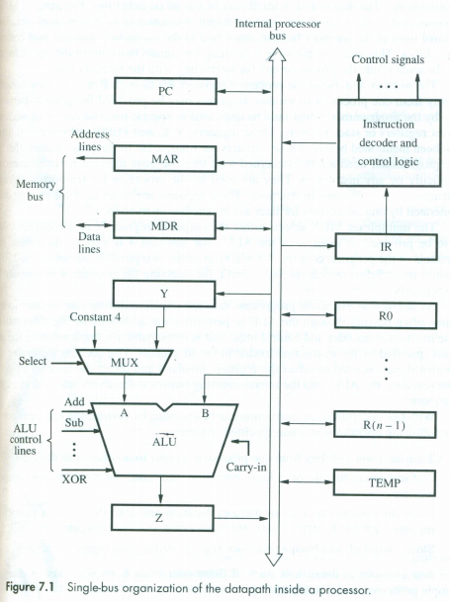

Slide 6
An instn is executed by performing one or more of following operation
Transfer a word of data from one processor reg to another or to ALU
Perform an arithmetic or logical operation and store result in register
Fetch content of MEM and load them in registers
STORE word from a register into MEM location

Slide 7
REGISTER TRANSFERS
Input and output of registers are controlled by switches Fig 7.2
To transfer contents of register R1 to R4.
→Enable output of R1 by setting R1out to 1—places contents of R1 on bus
→Enable input of R4 by setting R4in to 1—loads from processor bus to R4.
→registers consist of edge triggered flip flops so at next active edge of the clock the flip flop that constitute R4 will load the data present at their inputs.

Slide 8
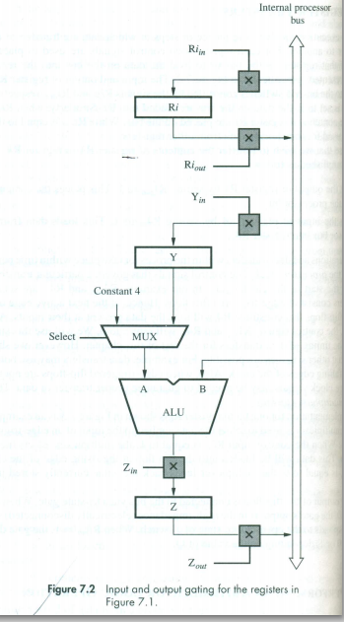

Slide 9
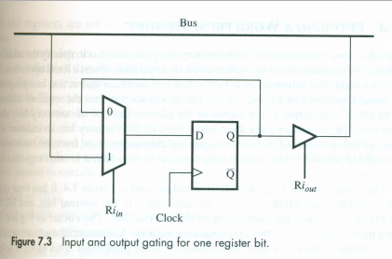

Slide 10
Performing an arithmetic or logic operation
ALU has no internal storage
Sequence of operations to add R1,R2→R3 is
→R1out,Yin
→R2out,SelectY,Add,Zin
→Zout,R3in
Last transfer cannot be carried out during step2 becz only one register output can be connected to the bus during any CC.

Slide 11
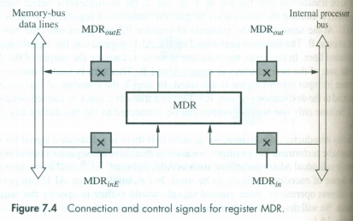
FETCHING A WORD FROM MEMORY
MAR
MDR Fig7.4
To accommodate the variability in response time, the processor waits until it receives an indication that read operation is complete → Memory Function Completed(MFC)
Example Move (R1),R2
MAR←[R1]
Start a READ operation on memory bus
Wait for MFC response from memory
(Depends on speed of the device )
4. Load MDR from memory bus
5. R2←[MDR]

Slide 12
Signals generated using memory read operation
R1_{out},MAR _{in}, Read
MDR_{inE}, WMFC
MDR_{out}, R2_{in}
→Fig 7.5

Slide 13
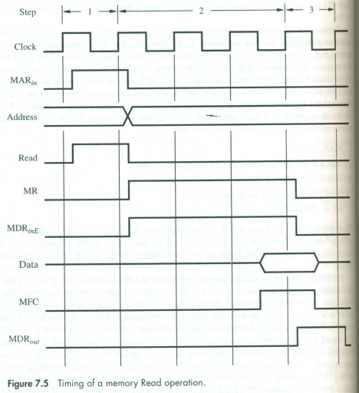

Slide 14
Storing a word in memory
MOVE R2,(R1)
R1_{out}, MAR_{in}
R2_{out},MDR_{in}, Write
MDR_{outE}, WMFC

Slide 15
Execution of one complete instruction
ADD (R3),R1
Actions taken to execute this instrn
Fetch the instn
First the first operand
Perform the addition
Load the result in R1

Slide 16
Sequence of control steps for ADD (R3),R1
PC_{out}, MAR_{in,}Read,Select4, Add,Z_{in}
Z_{out}, PC_{in,} Y_{in}, WMFC
MDR_{out}, IR_{in}
R3_{out,} MAR_{in,} Read
R1_{out,} Y_{in}, WMFC
MDR_{out,} SelectY, Add, Z_{in}
Z_{out}, R1_{in,}End

Slide 17
Branch Instruction(Branch<0)
PC_{out}, MAR_{in,}Read,Select4, Add, Z_{in}
Z_{out}, PC_{in,} Y_{in}, WMFC
MDR_{out}, IR_{in}
Offset-field-of-IR_{out,} Add, Z_{in}
Z_{out}, PC_{in,} End.
Branch<0
Offset-field-of-IR_{out,} Add, Z_{in} If N=0 then end.
→If N=0 the processor returns to step 1 immediately after step 4.
→If N=1 step 5 is performed to load a new value into PC.

Slide 18
Multiple Bus Organization
Control sequences in single bus organization were long as only one data item was transferred over the bus in one clock cycle.
To reduce number of clocks multi bus architecture was introduced.
Figure 7.8
Bus A,B for source C is for result.
In this architecture Y and Z registers are avoided
Use of incrementer elements PC+4 to be done using ALU
But constant 4 is still used for LoadMultiple and Store multiple

Slide 19
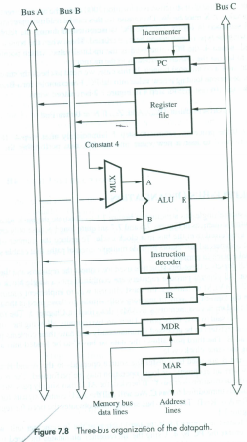

Slide 20
Add R4,R5,R6
PC _{out} ,R=B,MAR_{in},Read,IncPC
WMFC
MDR _{outB}, R=B,IR_{in}
R4_{outA},R5_{outB},SelectA,Add, R6_{in},End.

Slide 21
HARDWIRED CONTROL
Control signals generation
→Hardwired Control
→Microprogrammed control
Counter is used to keep track of number
of control steps Fig 7.10
Each count corresponds to one control
step

Slide 22
Required control signals are determined by the following information
Contents of the control step counter
Contents of the IR
Contents of CC flags
External ip signals, such as MFC and interrupt requests.
→Decode block is a combinational ckt and generates required control o/p
→Separation of decoder and encoder is shownin fig 7.11
→One INS will set at a time and others to 0.

Slide 23
Separate Encoder and Decoder
→Step decoder provides a separate signal line for each step/timeslot
→Output of decoder will have separate line for each instn

Slide 24
Control signal for Zin
Signal is asserted during timeslot T1 for all instn
ADD
PC_{out}, MAR_{in,}Read,Select4, Add,Z_{in}
Z_{out}, PC_{in,} Y_{in}, WMFC
MDR_{out}, IR_{in}
R3_{out,} MAR_{in,} Read
R1_{out,} Y_{in}, WMFC
MDR_{out,} SelectY, Add, Z_{in}
Z_{out}, R1_{in,}End
BRANCH
PC_{out}, MAR_{in,}Read,Select4, Add, Z_{in}
Z_{out}, PC_{in,} Y_{in}, WMFC
MDR_{out}, IR_{in}
Offset-field-of-IR_{out,} Add, Z_{in}
Z_{out}, PC_{in,} End.

Slide 25
Control signal for End
→End instrn starts a new instrn fetch cycle
By resetting the control step counter to its starting value
→RUN when equal to 1 , causes the counter to be incremented by one at the end of every CC. When RUN=0 the counter stops counting

Slide 26
Complete Processor

Slide 27
Microprogrammed Control
Control signals are generated by a program.
Each Control Word(CW) represents various control signals.
SelectY is represented by Select=0, Select4 as select=1
Microroutine is for an instruction.(Sequence of Control Words)
Individual Control Word is microinstruction.
Microroutine for all instructions are stored in special memory →Control Store.
Control unit can generate control signals for any instn by sequentially reading CWs of corresponding microroutine from control store.

Slide 28
PC_{out}, MAR_{in,}Read,Select4=1, Add,Z_{in}
Z_{out}, PC_{in,} Y_{in}, WMFC
MDR_{out}, IR_{in}
R3_{out,} MAR_{in,} Read
R1_{out,} Y_{in}, WMFC
MDR_{out,} SelectY=0, Add, Z_{in}
Z_{out}, R1_{in,}End

Slide 29
→To read CW from control store μPC is used.
→Starting address generator will give address of microroutine
→Clock will increment micro PC

Slide 30
Microroutine for Branch<0

Slide 31
Control Unit to support branch instruction
The μPC is incremented every time a new instn is fetched from microprogram memory, except in the following situations
When a new instn is loaded into IR, the μPC is loaded with the starting address of the microroutine for that instn
When a branch microinstn is encountered and the branch condition is satisfied, the μPC is loaded with the branch address.
When an End microinstn is encountered , the μPC is loaded with the address of the first CW in the microroutine for the instn fetch cycle.

